Slide 1
Stochastic Shortest Path Maze
Rohini S
CB.EN.R4CSE22002-FT

Slide 2
Stochastic Shortest Path Problem
Stochastic shortest path problem is a generalization whereby, at each node, we must select a probability distribution over all possible successor nodes, out of a given set of probability distributions. It is a well-known problem in planning and control, in which an agent must reach a goal state with minimum expected cost.
Stochastic shortest path (SSP) is one of the most basic models in reinforcement learning (RL). It features an agent that interacts with a Markov decision process (MDP) to reach a predefined goal state in a minimum expected cost.

Slide 3
Advantages of implementing Reinforcement learning over Common approaches for Maze problem
A common approach to solving a deterministic maze navigation problem is path planning based on some search algorithms such as the A∗ search algorithm. However, the environment here is stochastic. The probabilistic nature of the state transition is challenging for traditional search algorithms, although this can be accomplished with some dynamic extensions of the standard search algorithms. In addition, the task might not be known to the agent explicitly. In other words, the agent must discover by itself the task of completing the maze. The great thing about reinforcement learning is that we can apply such a learning system to many different situations by guiding the system with reward feedback. We can even change the task by changing the reward feedback. There should be no need to change anything in the program of the agent. Such training is typical when training animals as reward feedback is usually the main way to communicate with the animals in learning situations since we can not verbally communicate the goal of the task that we have in mind.

Slide 4
The Markov Decision Process (MDP)
The Markov Decision Process (MDP) provides a mathematical framework for solving the Reinforcement Learning problem. Almost all RL problems can be modeled as an MDP. MDPs are widely used for solving various optimization problems.
We can use Reinforcement Learning to solve problems with the Markov Property exactly because the current state is a sufficient statistic of the future. In other words, the state encodes the distribution of future states.
Solving MDPs in lower time complexities is desirable for large problems, as MDPs are widely used as a basis for decision-based learning. Two basic algorithms for solving MDPs are valued iteration and policy iteration

Slide 5
The Markov Decision Process
we consider an agent that should learn to navigate through the maze. The states of the maze are the
possible discrete positions that are simply numbered consecutively, let S = {1, 2, ..., 18} The possible actions of the agent is to move one step forward, either to the north, east, south or west, that is, A = {N,E,S,W}. However, even though the agents give these commands to its actuators, stochastic circumstances – such as faulty hardware or environmental conditions (e.g. some instructor ‘kicking’
the agent) – make the agent end up in different states with certain probabilities. The probabilities are specified by a transition matrix T(s|s, a)

Slide 6
The Markov Decision Process
We now formalize such an environment as a Markov Decision Process (MDP). A MDPis characterized by a set of 5 quantities, expressed as (S, A, T(s |s, a),R(r|s, a), θ). The meaning of these quantities are as follows.
• S is a set of states.
• A is a set of actions.
• T(s |s, a) is a transition probability, for reaching state s when taking action a from state s. This transition probability only depends on the previous state, which is called the Markov condition; hence the name of the process.
• R(r|s) is the probability of receiving reward when getting to state s. This quantity provides feedback from the environment. r is a numeric value with positive values indicating reward and negative values indicating punishment.
• θ are specific parameters for some of the different kinds of RL settings. This will be the discount factor γ in our first examples.
An MDP is fully determined by these 5 quantities that characterize the environment completely.

Slide 7
Different Methods
1. Value Iteration: The value iteration approach finds the optimal policy π* by calculating the optimal value function, V*. Starting with V(s) = 0 for all states s, the values of each state are iteratively updated to get the next value function V, which converges towards V*.
2. Policy Iteration: Starting with a random policy π0, this approach consists of two steps:
Calculate the utilities of a non-optimal policy πi
Update the policy using the resulting converged utilities from the previous step to obtain πi+1.
These steps are repeated until π converges to π*

Slide 8
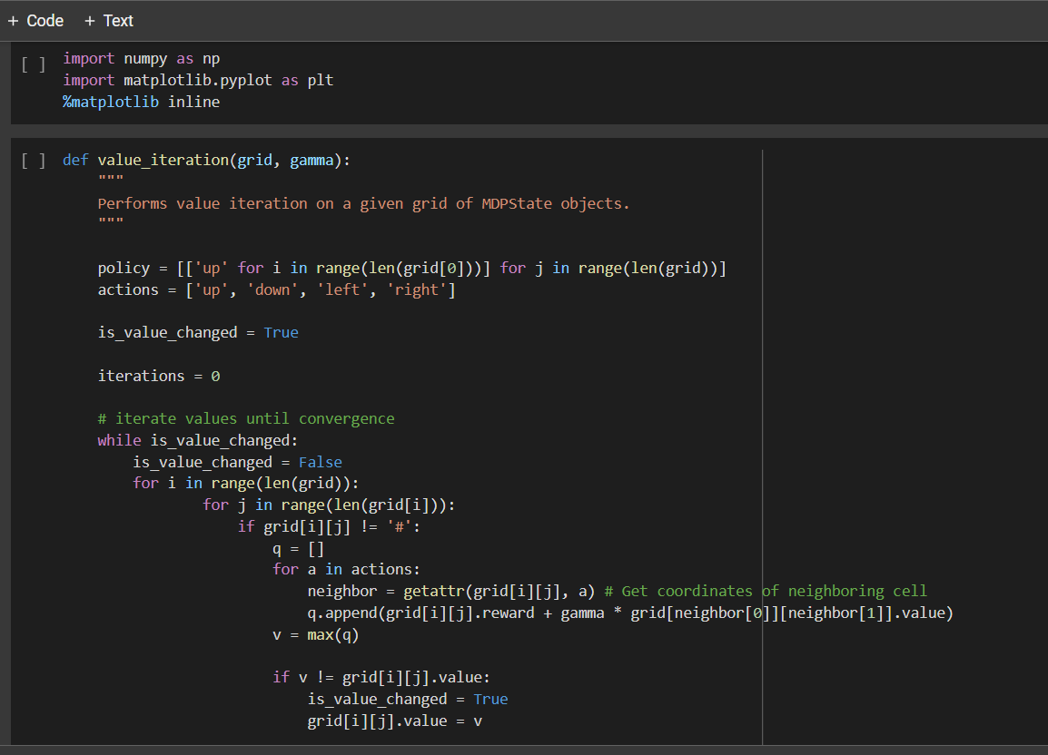
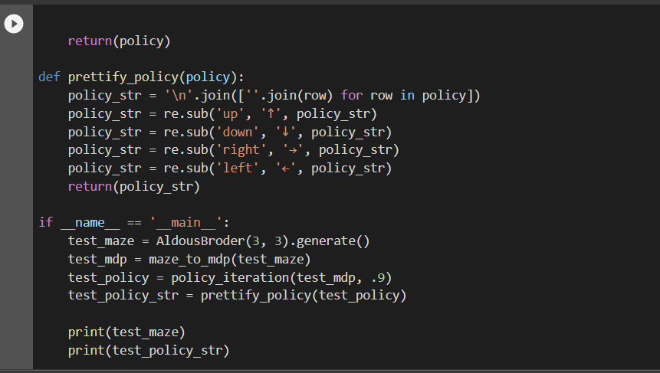
Policy Iteration Method

Slide 9
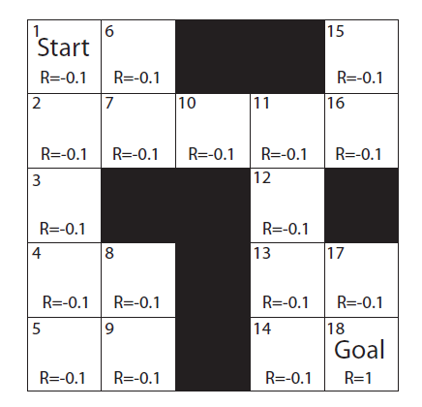
Maze Problem
We can also look into the maze problem as the probability of following actions a = N might just be 80% as it might end up in the west state (taking actions a = W) or the east state (taking action and a = E) in 10% of the cases each never goes erroneously south. We assume for now that the transition Probability is given explicitly, although in many practical circumstances, we might need to estimate this from examples (e.g. supervised learning).
Fig. 01.1 A maze where each state is rewarded with a value r.

Slide 10
Maze Problem
In the maze as illustrated in Figure 01.1, some of the states are not reachable as they represent a wall. We can take this into account by making the transition matrix state dependent. Here we simply consider that when taking an action that would drive the robot into a wall would simply though back the robot in the starting position. Finally, the agent is given a reward or punishment when the agent is moving into a new state s. For example, we can consider a deterministic reward function in which the agent is given a large reward when finding the exit to the maze (r(18) = 1 in the example of Figure 10.1). In practice, it is also common and useful to give some small negative rewards to the other states. This could, for example, represent the battery resource that the Lego robot consumes when moving to a cell in the grid, whereas it gets recharged at the exit of the maze.

